Slide 1
Cryptography and Network Security
BLOWFISH

Slide 2
Session Meta Data
Author | Dr T Sree Sharmila
Reviewer
Version Number | 1.0
Release Date | 8 July 2018

Slide 3
Revision History
Revision Date | Details | Version no.
 |  | 1.0

Slide 4
Agenda
Introduction
Blowfish
Summary
Test your understanding
References

Slide 5
Introduction
a symmetric block cipher designed by Bruce Schneier in 1993/94
Blowfish is a keyed, symmetric block cipher, designed in 1993 by Bruce Schneier and included in a large number of cipher suites and encryption products. (Wikipedia)
Blowfish is a symmetric block cipher that can be used as a drop-in replacement for DES or IDEA. (Bruce Schneier)
characteristics
fast implementation on 32-bit CPUs, 18 clock cycles per byte
compact in use of memory, less than 5KB
simple structure for analysis/implementation
variable security by varying key size
Allows tuning for speed/security tradeoff

Slide 6
Agenda
Introduction
Blowfish
Summary
Test your understanding
References

Slide 7
Blowfish Key Schedule
uses a 32 to 448 bit key
used to generate
18 32-bit subkeys stored in P-array: P1 to P18
S-boxes stored in S_{i,j,}
i=1..4
j=0..255

Slide 8
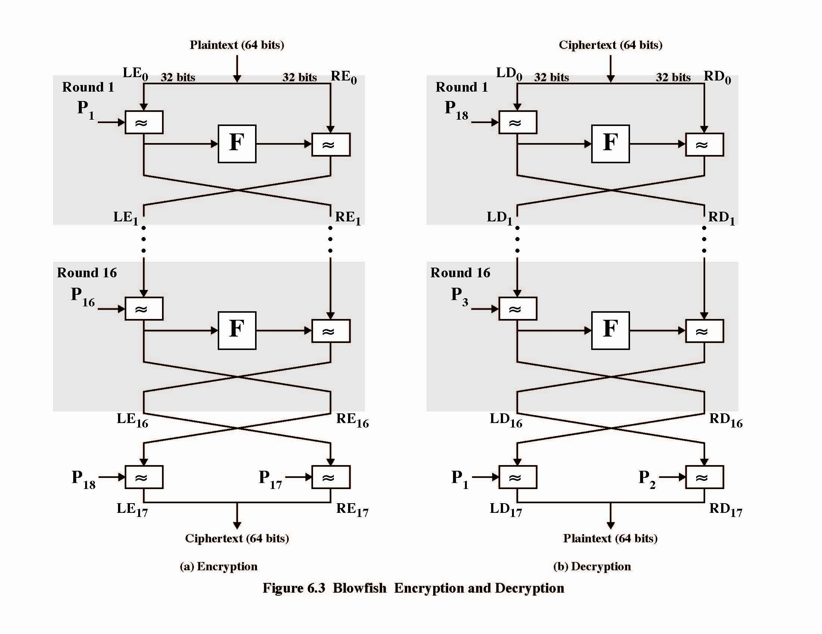
Blowfish Encryption & Decryption

Slide 9
Blowfish Encryption
uses two primitives: addition & XOR
data is divided into two 32-bit halves L₀ & R₀
for i = 1 to 16 do
R_{i} = L_{i-1} XOR P_{i};
L_{i} = F[R_{i}] XOR R_{i-1};
L₁₇ = R₁₆ XOR P₁₈;
R₁₇ = L₁₆ XOR i₁₇;
where
F[a,b,c,d] = ((S_{1,a} + S_{2,b}) XOR S_{3,c}) + S_{4,a}
Break 32-bit R_{i} into (a,b,c,d)

Slide 10
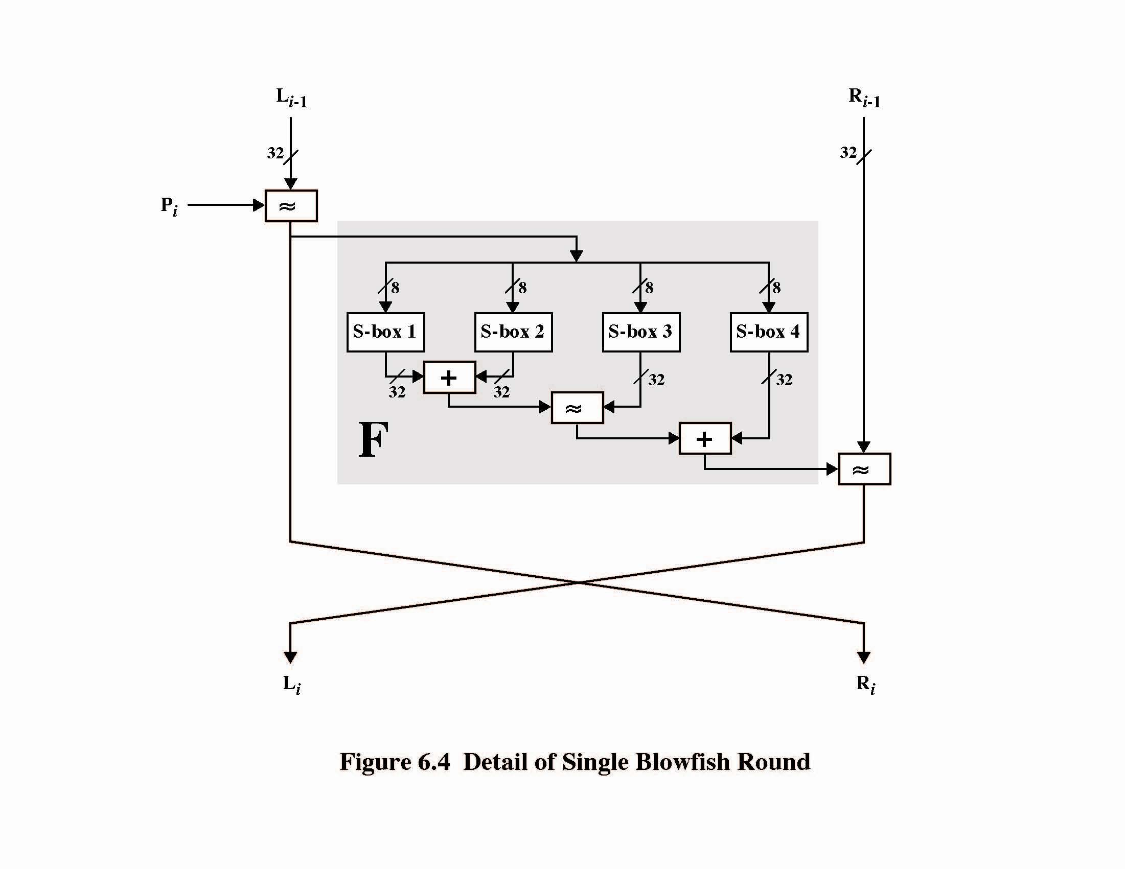
Blowfish Round Structure

Slide 11
Agenda
Introduction
Blowfish
Summary
Test your understanding
References

Slide 12
Summary
provided key is large enough, brute-force key search is not practical, especially given the high key schedule cost
key dependent S-boxes and subkeys make analysis very difficult
Very few cryptoanalysis results on blowfish
changing both halves in each round increases security
Some study shows improved avalanche effects

Slide 13
Agenda
Introduction
Blowfish
Summary
Test your understanding
References

Slide 14
Test your understanding
Explain Blowfish algorithm in detail.

Slide 15
Agenda
Introduction
Blowfish
Summary
Test your understanding
References

Slide 16
References
1. William Stallings, Cryptography and Network Security, 6th Edition, Pearson Education, March 2013.
2. Charlie Kaufman, Radia Perlman and Mike Speciner, “Network Security”, Prentice Hall of India, 2002.

